Slide 1
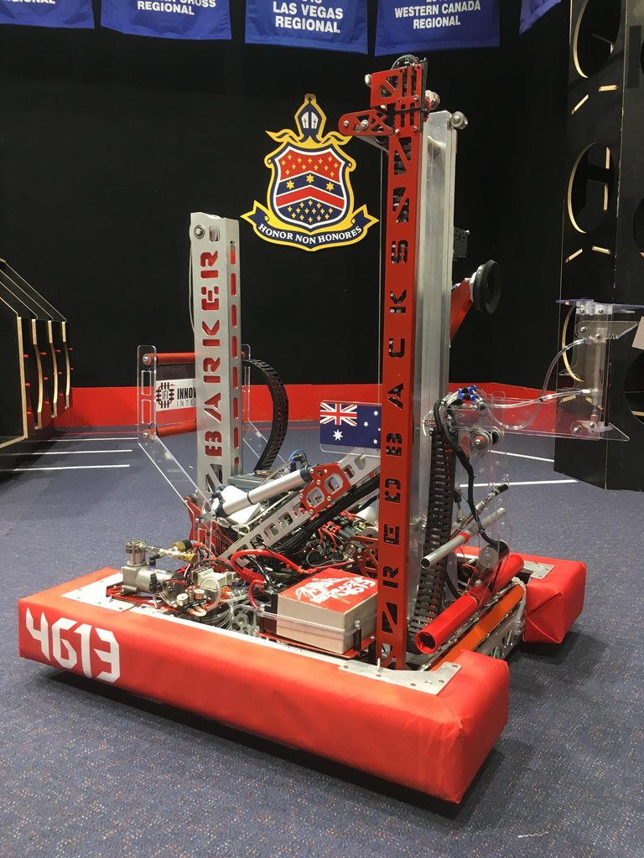

Binary Selection
Overall Topic: Hardware
Basic Workshop 1.4

Slide 2

Introduction to selection
What is selection?
A decision made in a program
Between
Code to run
Values to use
What makes selection ‘binary’?
A decision based on the truth of a boolean value
Has exactly 2 options
…
false
Binary Selection
true
…

Slide 3

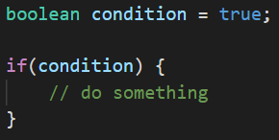
The if-statement
An if-statement
Is given a boolean condition
Runs the code inside the braces if the condition is true
Like in functions, variables created inside the braces of an if-statement cease to exist once it finishes running.

Slide 4

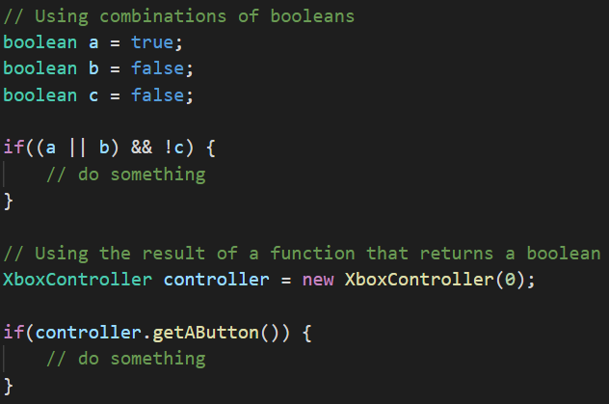
Conditions
Conditions can be any expression that results in a boolean:
The result of boolean operations (&&, ||, !)
A call to a function returning a boolean
The result of a comparison

Slide 5
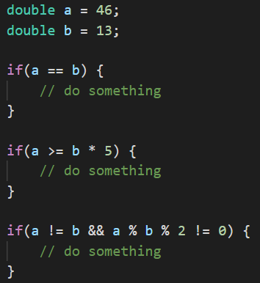
Comparison operations
Comparison operators allow us to change non-boolean values into conditions.
Operator | Meaning
x == y | is equal to
x != y | is not equal to
x > y | is greater than
x < y | is less than
x >= y | is greater than or equal to
x <= y | is less than or equal to

Slide 6
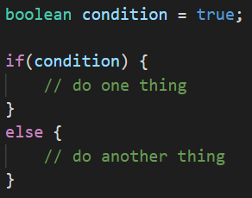
Adding else
An else-statement
Can only come after an if-statement
Runs only if the if-statement’s condition was NOT true

Slide 7
Your turn
Navigate to the location where you stored the tutorial repository from workshop B1.2, and open Git Bash in this location (on Windows, right click -> Git Bash here).
If you haven’t downloaded the tutorial repository, you’ll need to open Git Bash where you want to download it, then run the command “git clone https://github.com/ArachneTutorials/Tut-B1-Hardware.git” instead of the commands below.
Run the commands “git fetch” and then “git pull” to download the latest changes from the online repository.
Open Visual Studio Code in the Lesson 4 folder.
Complete section 1 of the Tasks file in the lesson.selection.tasks package (located at src/main/java/lesson/selection/tasks/Tasks.java)

Slide 8
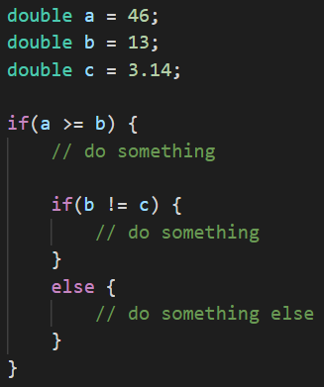
Nesting if-else-statements
We can put if-else-statements within other if-else-statements to branch into more than 2 paths.
If we could use a single if-statement with a complex condition (using &&, ||, !), we should do so rather than adding nested statements.

Slide 9
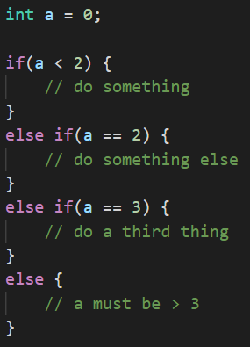
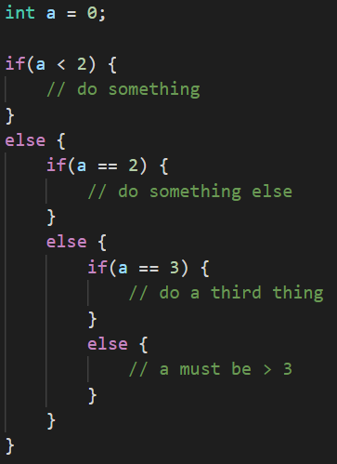
Else-if
An else-if-statement
Is added after an if-statement or another else-if-statement
Runs if its condition is true and all previous conditions are NOT true
=

Slide 10

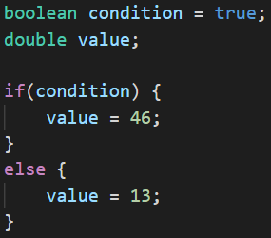
Ternary operators
Ternary operators allow us to select a value without writing a full if-statement.
Format:
condition ? valueIfTrue : valueIfFalse
=

Slide 11
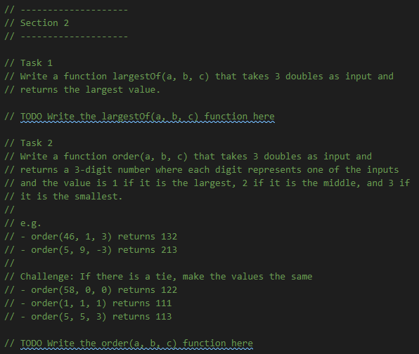
Your turn
Complete section 2 of the Tasks file.
If you have time, attempt the challenge question in Task 2. It is not easy, but can be completed using only code you’ve already learnt.

Slide 12
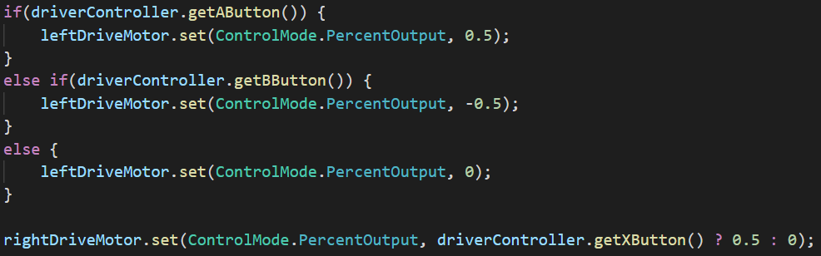
Selection on a robot
On a robot we can do something different given different
Sensor inputs
Controller inputs
Internally calculated values

Slide 13
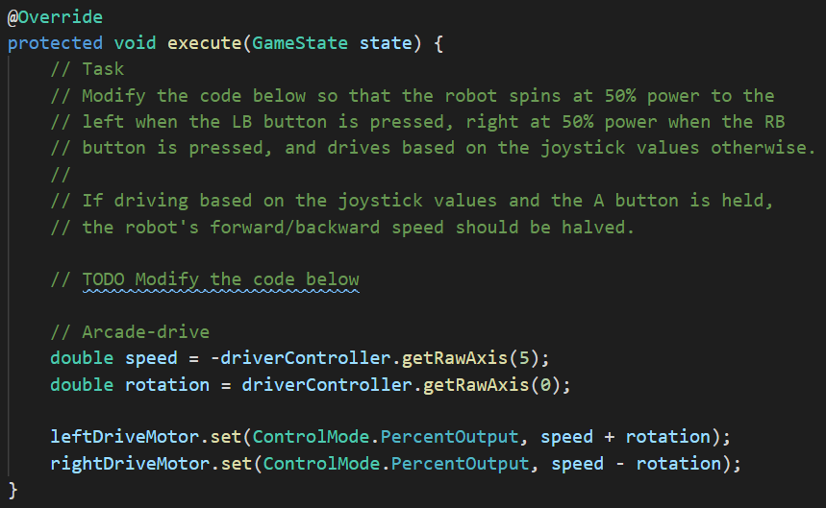
Your turn
Complete the task in the Robot file in the lesson.selection.tasks package.
Once you have code you expect to work, you can request to test it on the practice robot.

